Slide 1
Pathways Through College The Journey of Three Students Pursuing Goals
Student Leadership Conference
Reno, Nevada
November 2019
Notes:
Hi, my name is Jean Hauff and I am presenting about Pathways through college.

Slide 2
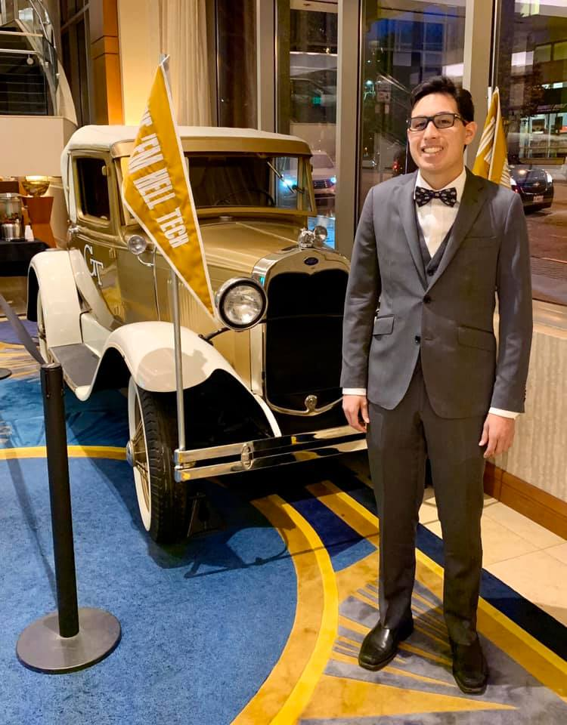
Pathways Through College: The Journey of Antonio Pursuing His Goals
PRESENTED BY ANTONIO E. CONTRERAS

Slide 3
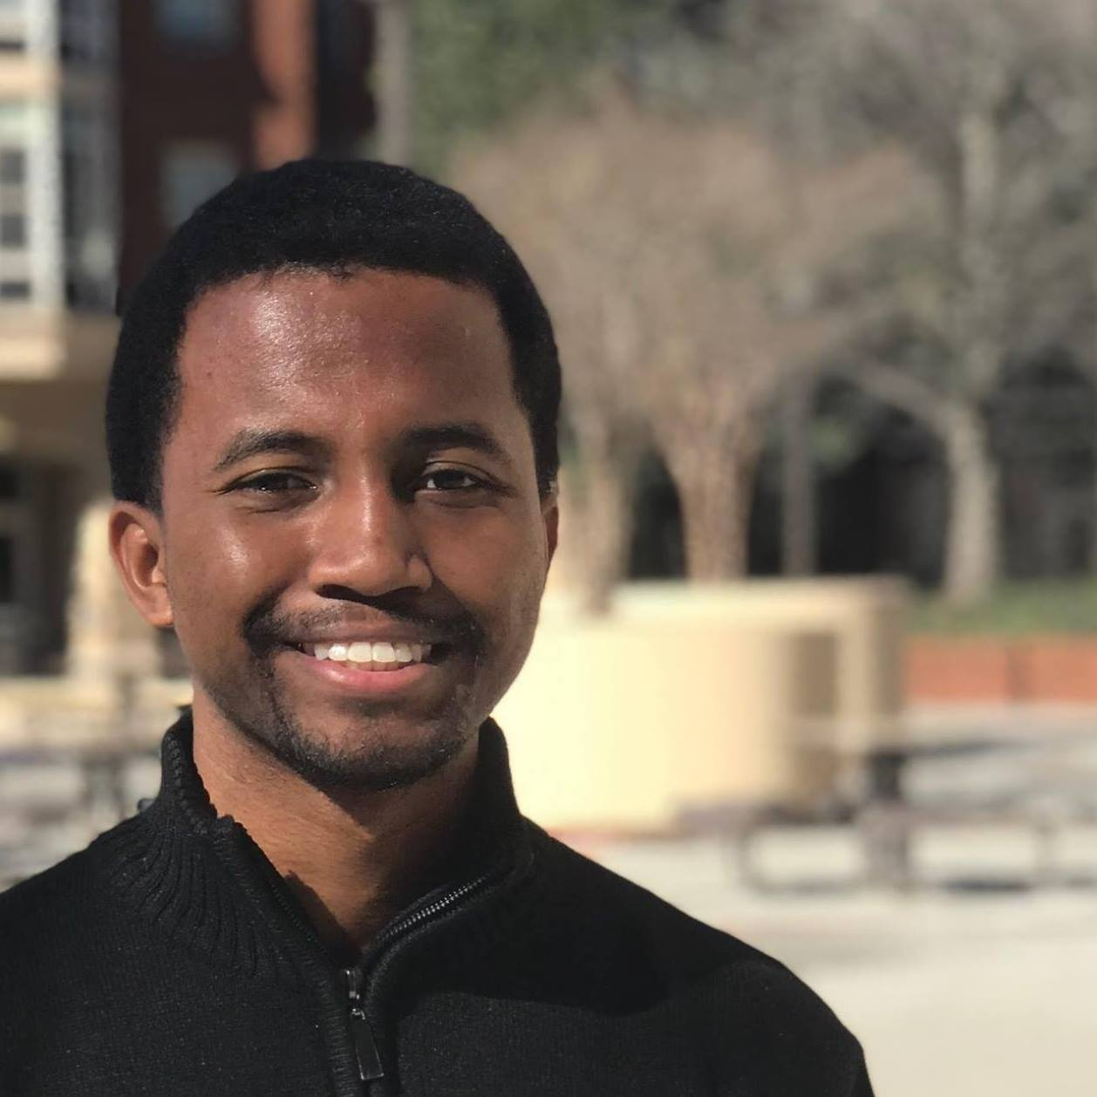
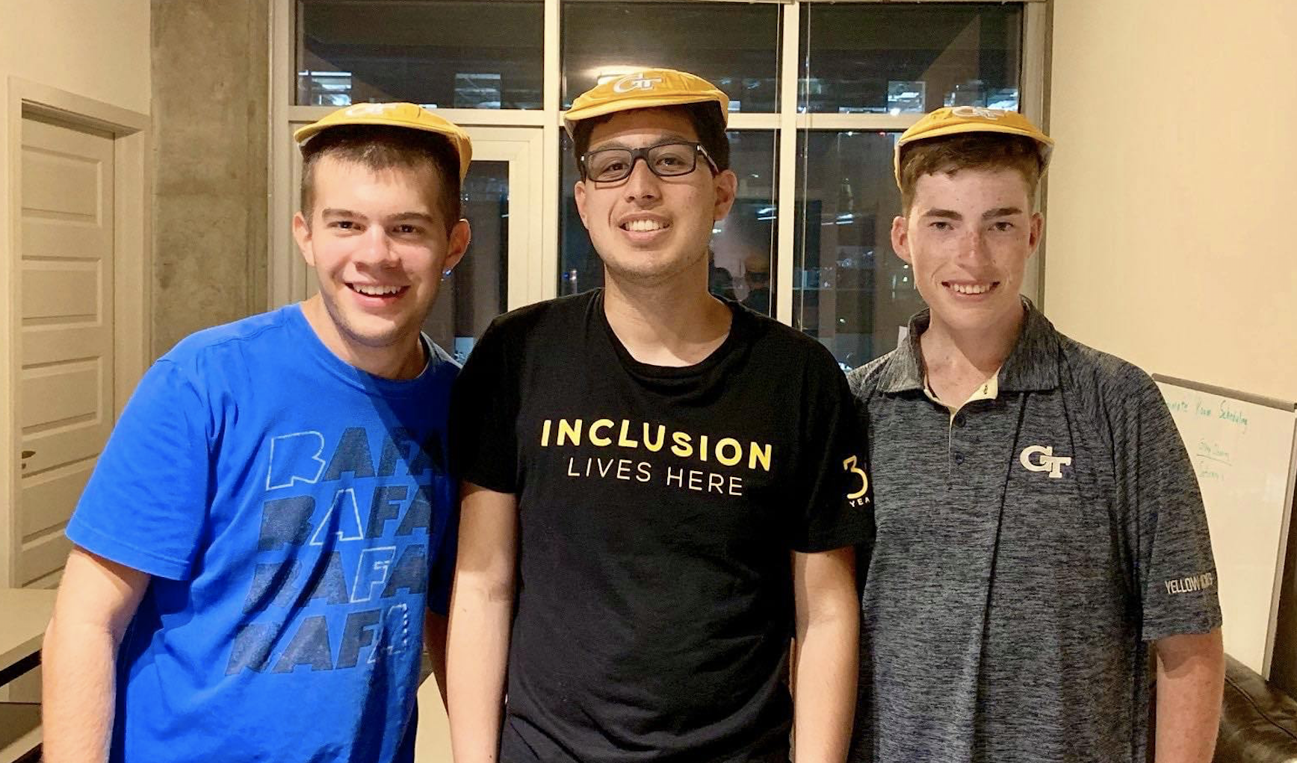

Slide 4
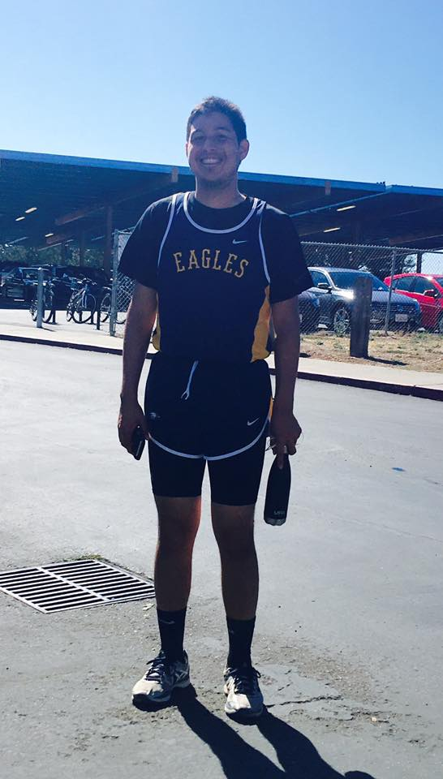
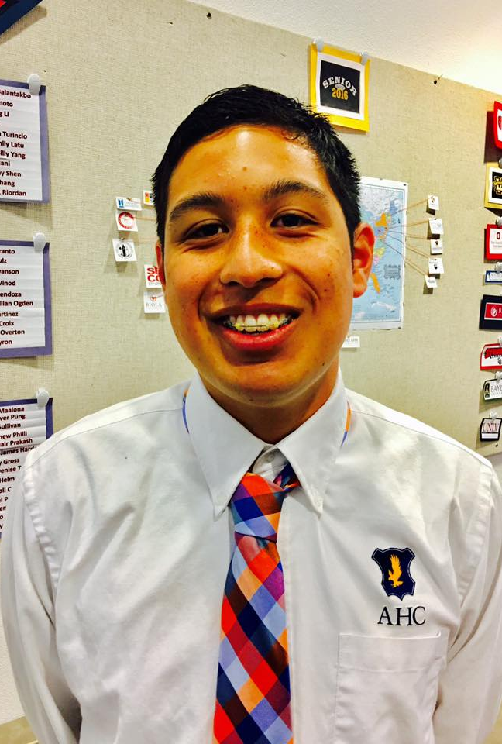
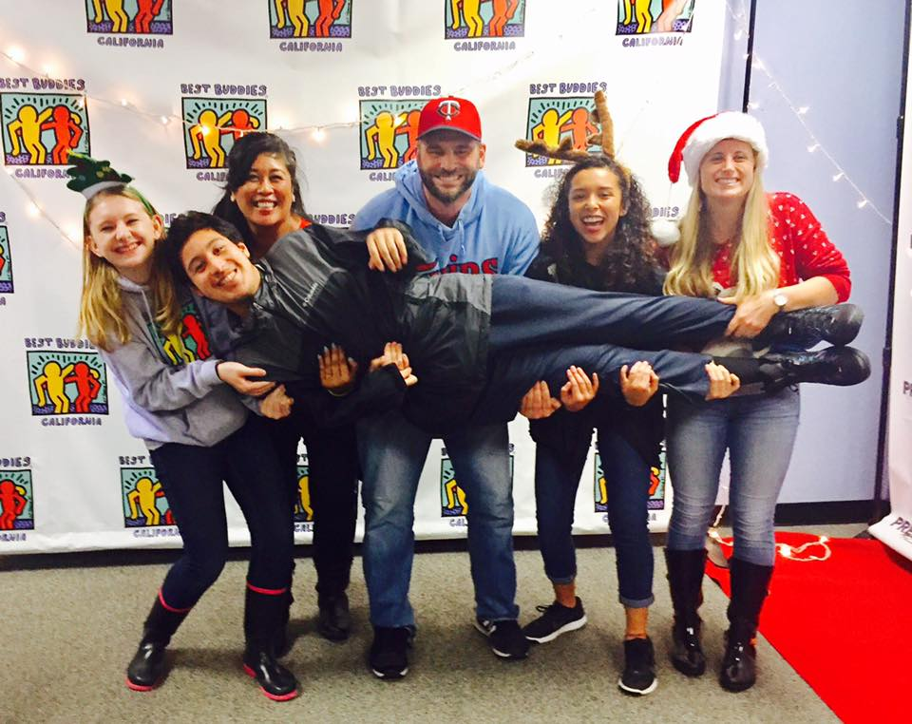

Slide 5
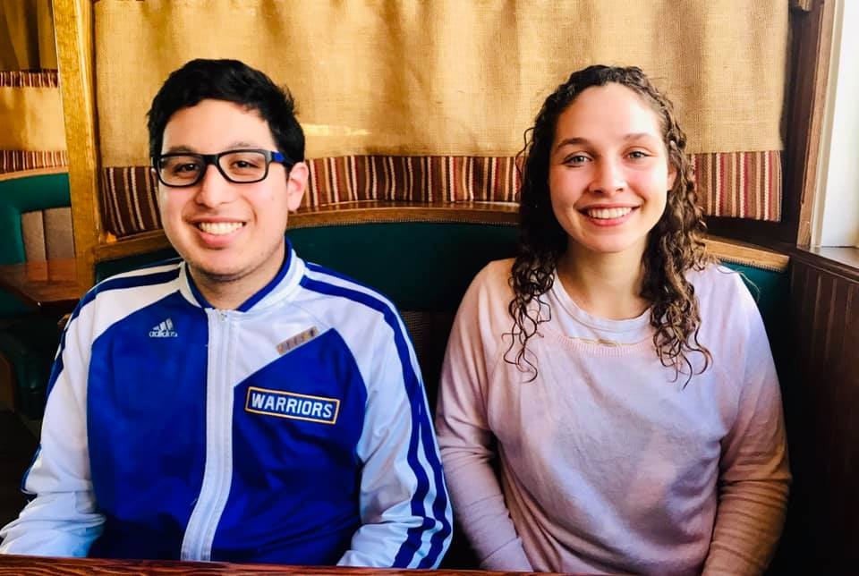
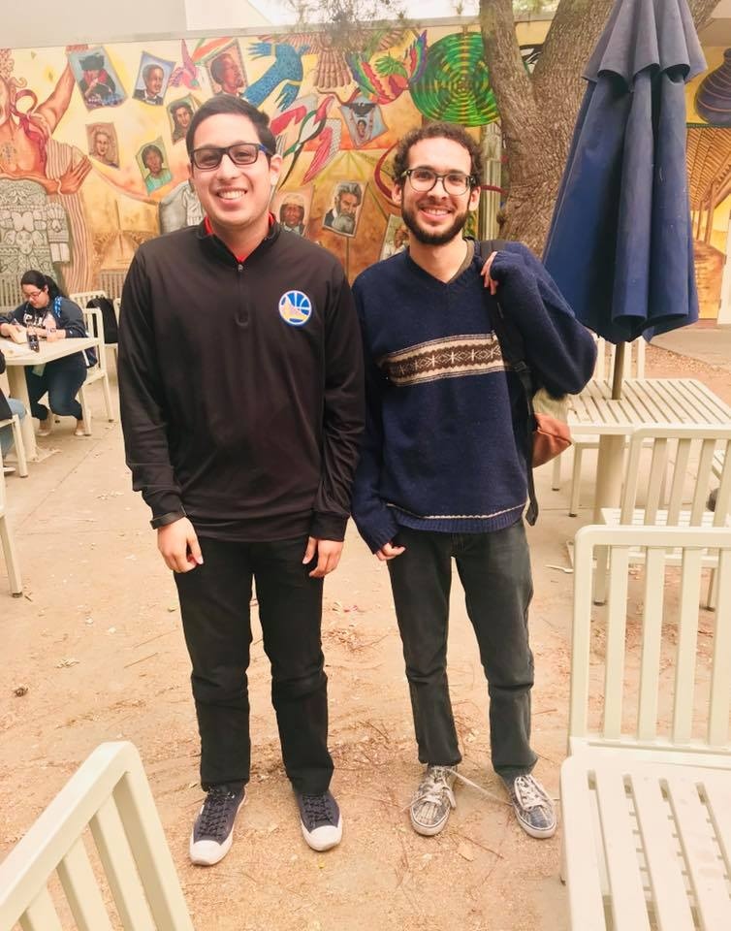
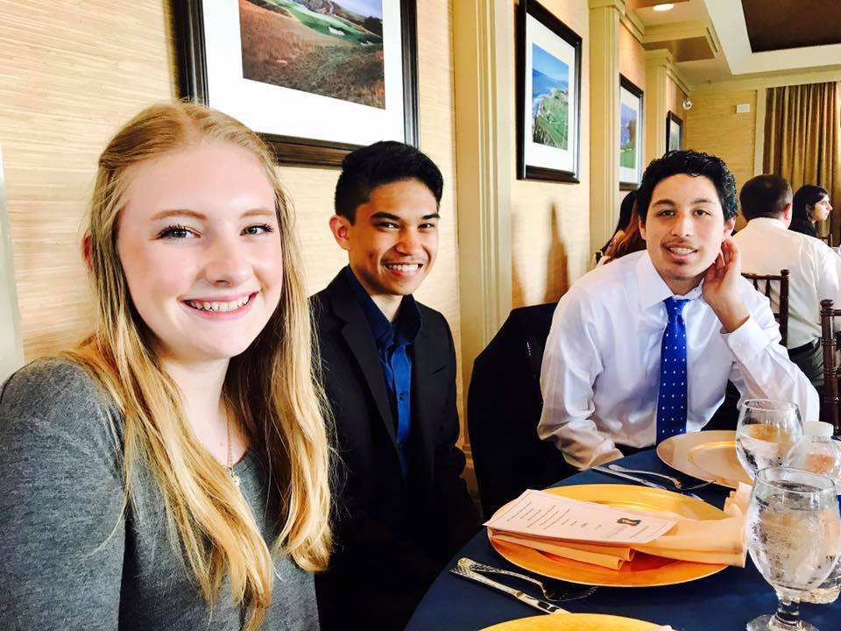

Slide 6
friends
family
own house
career

Slide 8
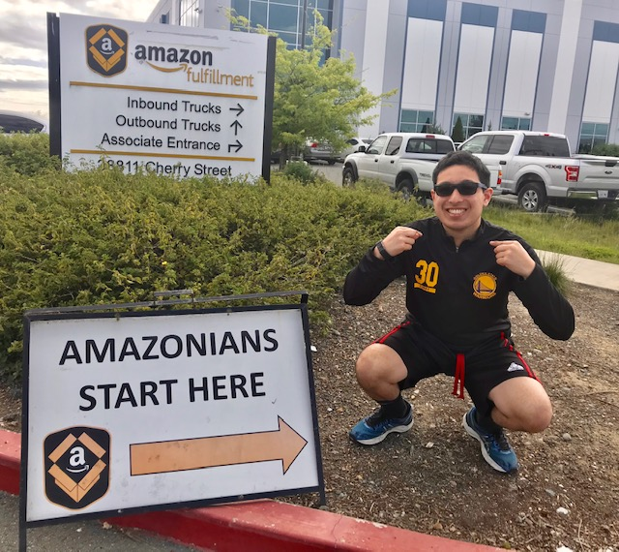
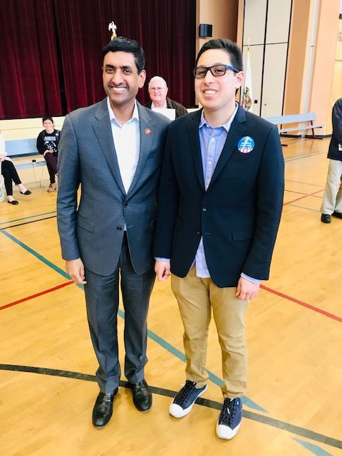
Goals Example 1
gap year | in college | after college
Find a paid job and an internship | Take classes and internships to help me find a good career | Have a career where I can use my strengths

Slide 9
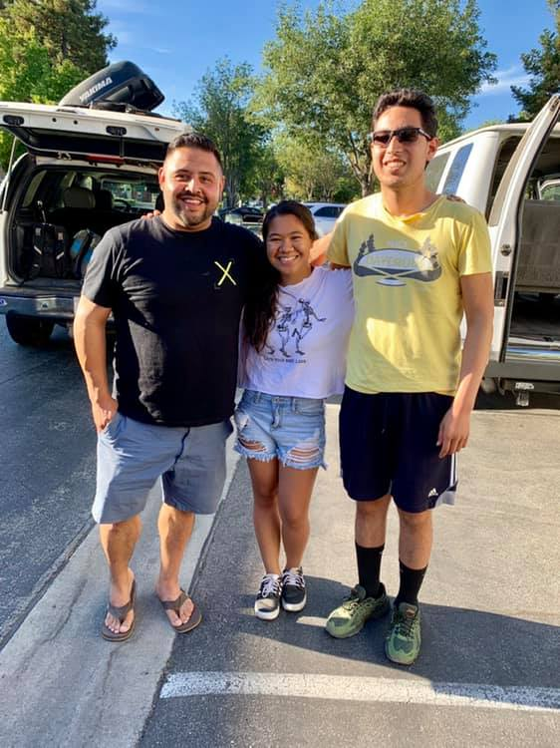
Goals Example 2
gap year | in college | after college
Join a young adult group at church | Join Best Buddies and a church group | Have a good group of friends who look out for me and who I can trust

Slide 10
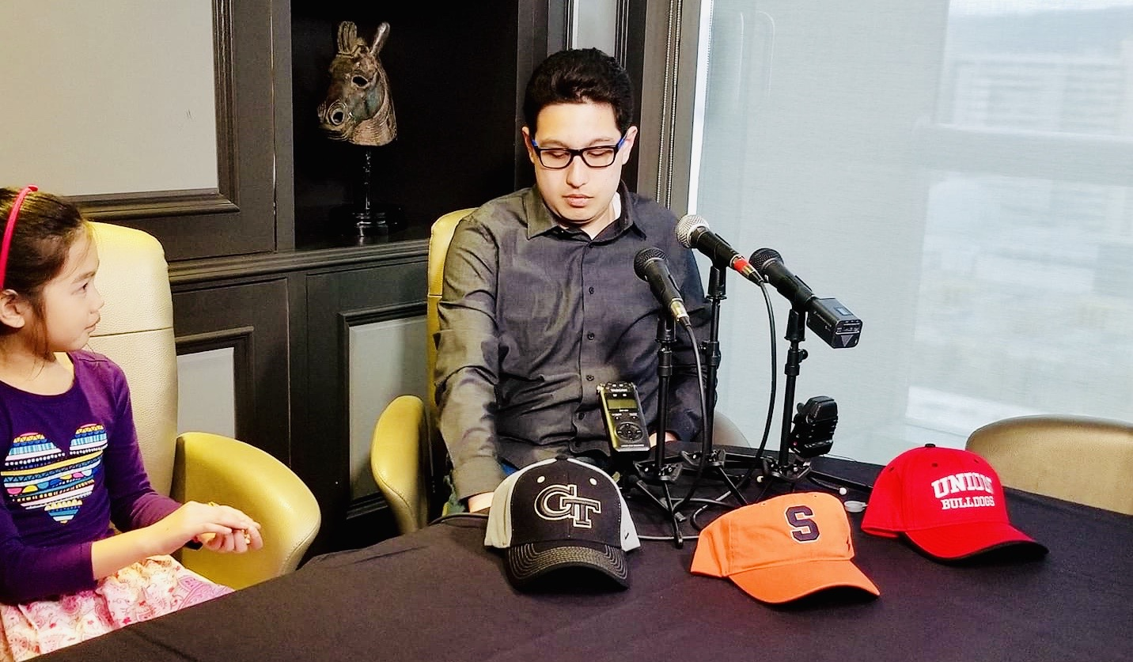

Slide 12
Antonio E. Contreras
acontreras31@gatech.edu
510.936.1104
Notes:
Hi, my name is Jean Hauff and I am presenting about Pathways through college.

Slide 13
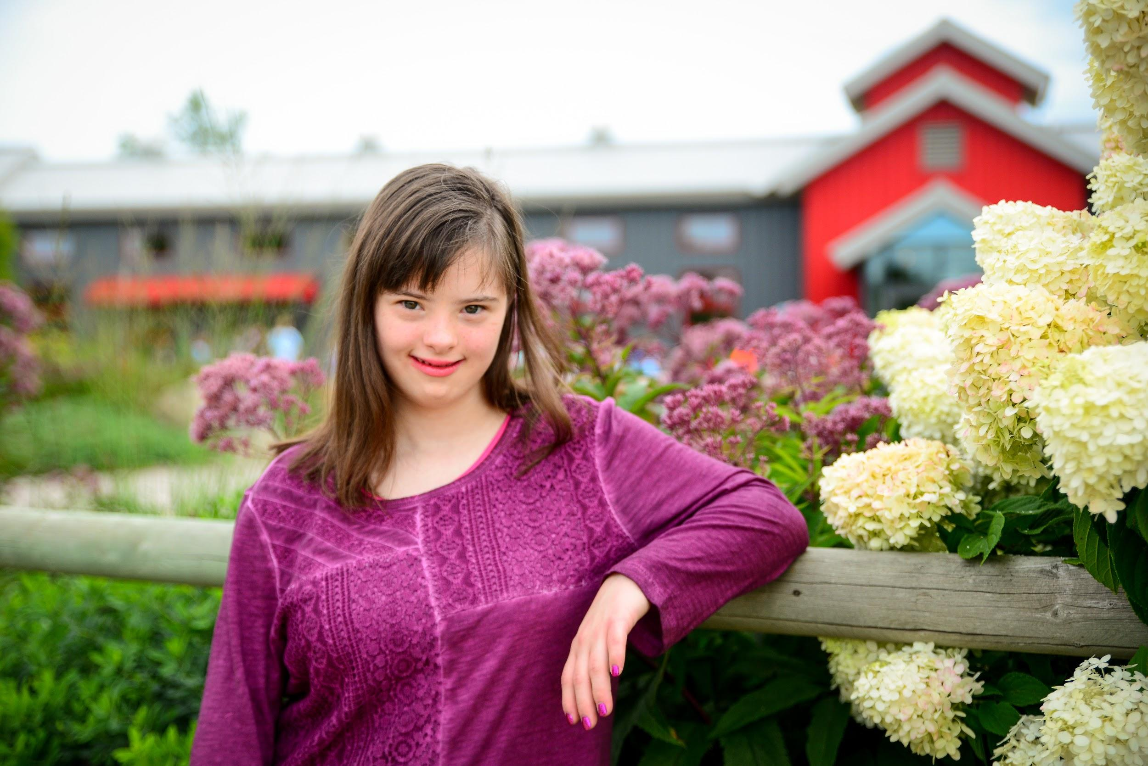
Pathways Through College: the journey of Jean pursuing her goals.
BY JEAN HAUFF
Notes:
Hi, my name is Jean Hauff and I am presenting about Pathways through college.

Slide 14
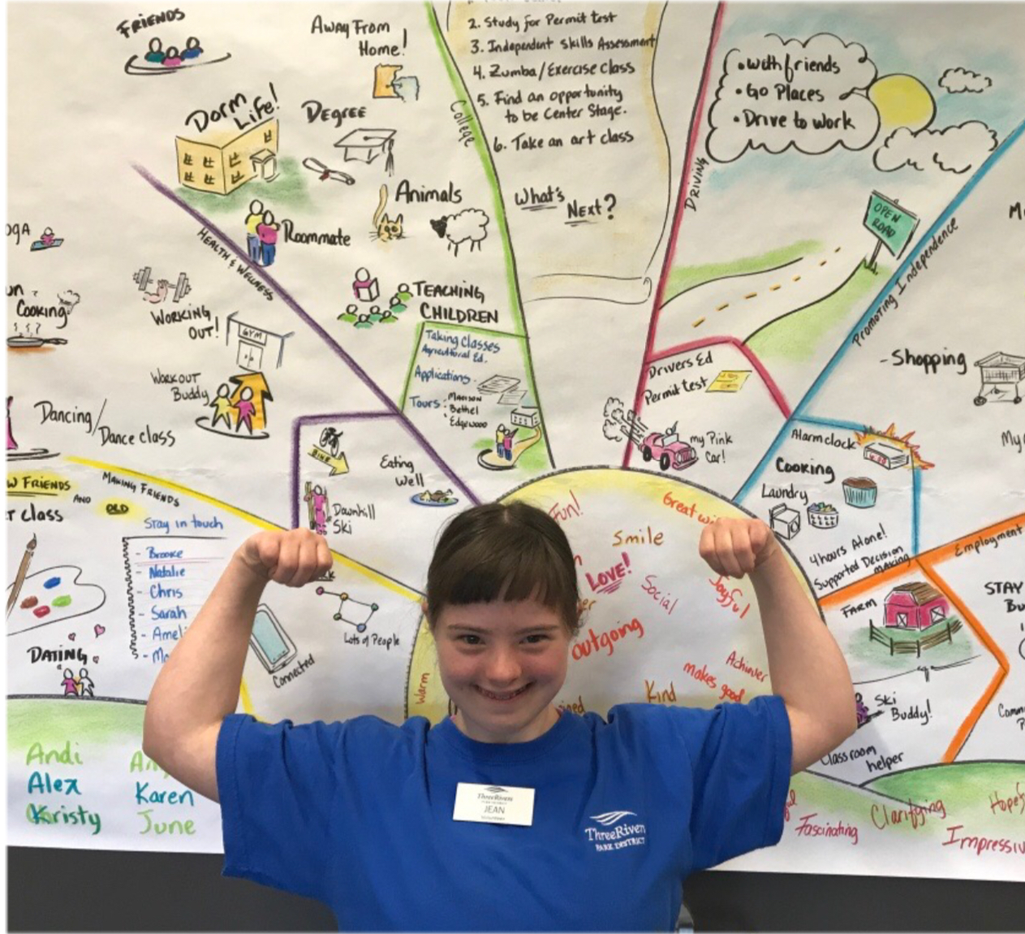
LIBERTY PLAN
Person Centered Planning
Notes:
This is my liberty plan. We talked about what I want for my future. We talked about health and wellness, college, driving, promoting independence and employment.

Slide 15
LEARNING ABOUT COLLEGES
VISITED COLLEGES
RIDGEWATER COLLEGE
BETHEL UNIVERSITY
EDGEWOOD COLLEGE
Notes:
I learned about colleges. I visited Ridgewater College, Bethel University and Edgewood College.

Slide 16
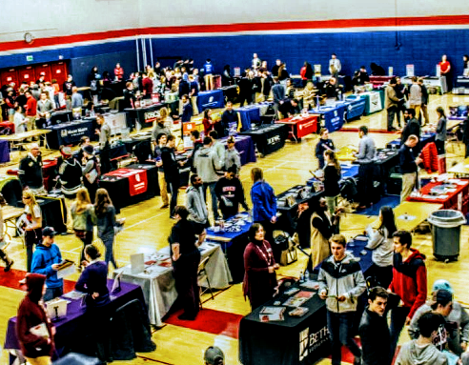
ATTENDED COLLEGE FAIR AND TALKED TO COLLEGES
Notes:
I attended the college fair and talked to colleges.

Slide 17
TAKING COLLEGE CLASSES
ED2GO- VETERINARY ASSISTANT, BLOGGING AND SOCIAL MEDIA
SW METRO- AGRICULTURAL CAREERS
RIDGEWATER COLLEGE – INTRO TO VETERINARY SCIENCES
Notes:
I take college classes. I take Veterinary assistant, blogging and social medias classes at Ed2go. I take agricultural career class at SW Metro. I take intro to veterinary science classes at Ridgewater College.

Slide 18
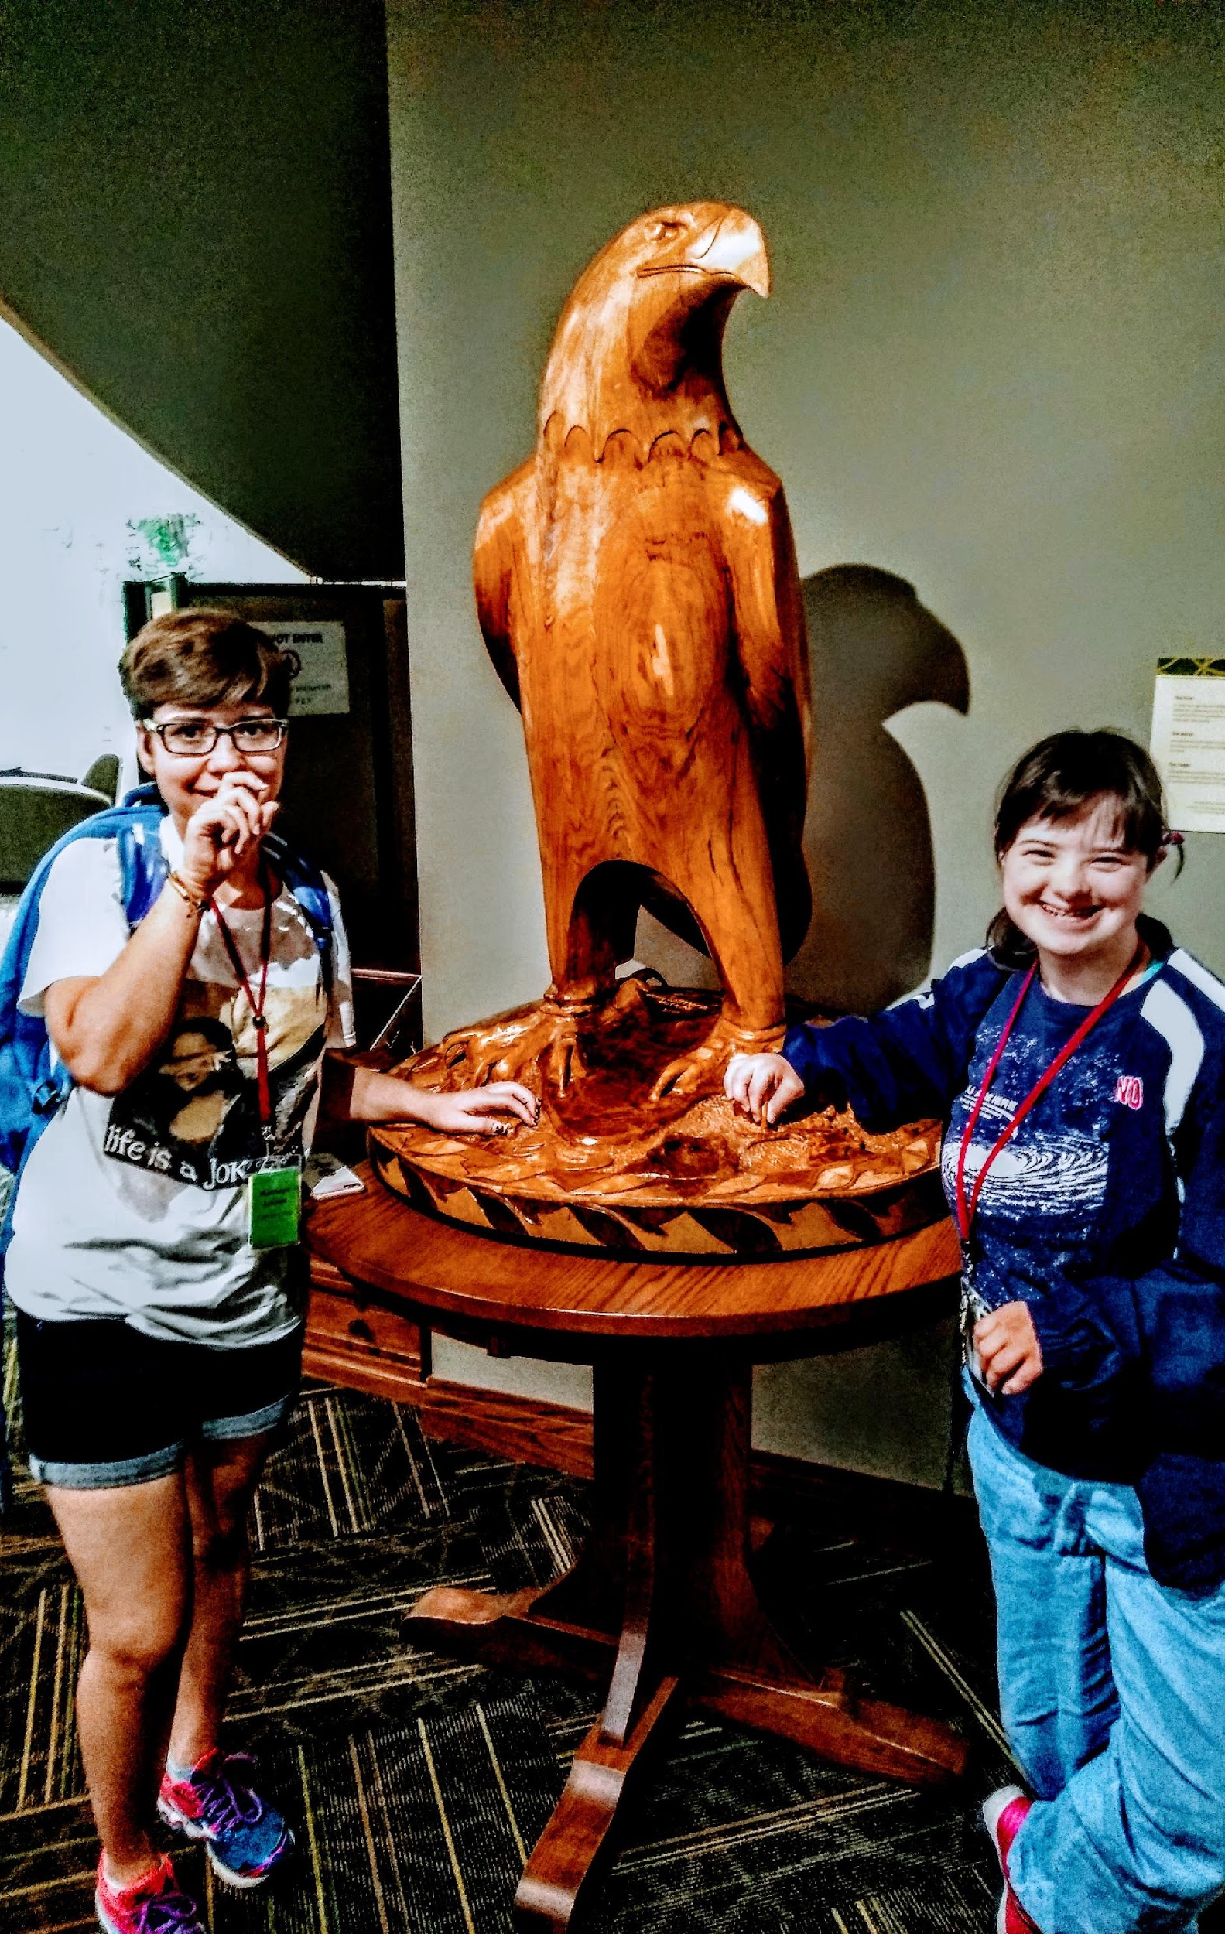
Attending a Pre College SUMMER PROGRAM
Edgewood College
One week college experience
Madison, WI
Notes:
I attended a pre college summer program at Edgewood College. It was one week at Madison, WI.
In the picture is a bald eagle and I made a new friend.

Slide 19
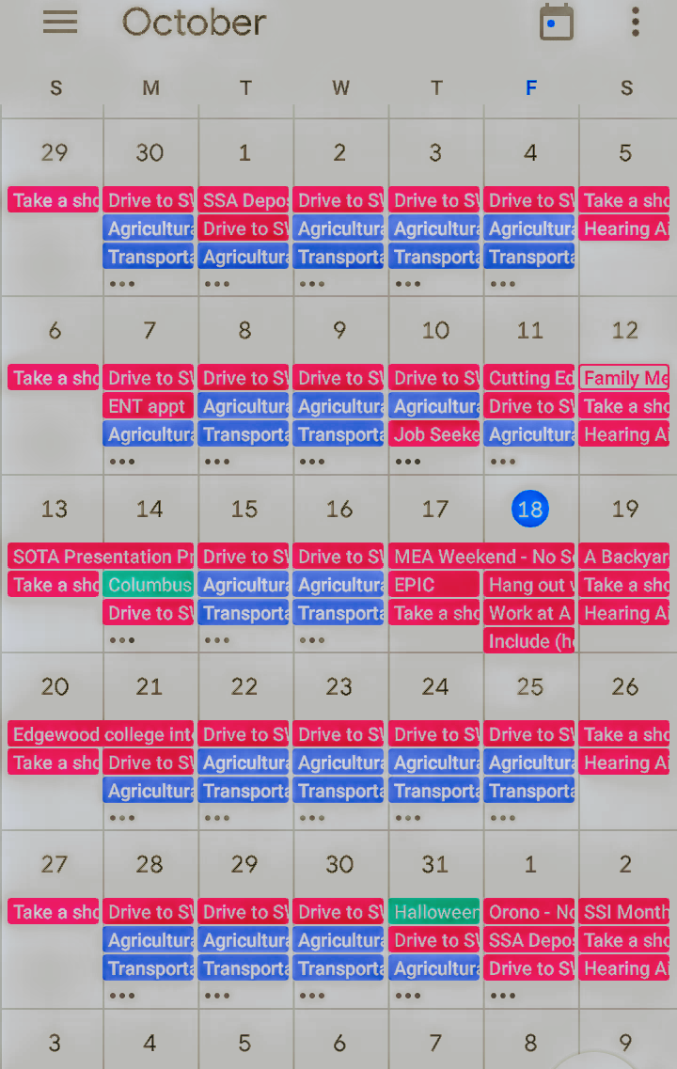
MANAGING MY CALENDAR
INDEPENDENTLY MANAGING MY TIME
GETTING UP IN THE MORNING
BEING READY ON TIME
Notes:
I manage my calendar. I manage my time, getting up in the morning and being ready on time. This picture is my calendar. It includes my classes, work schedule, appointments and other activities.

Slide 20
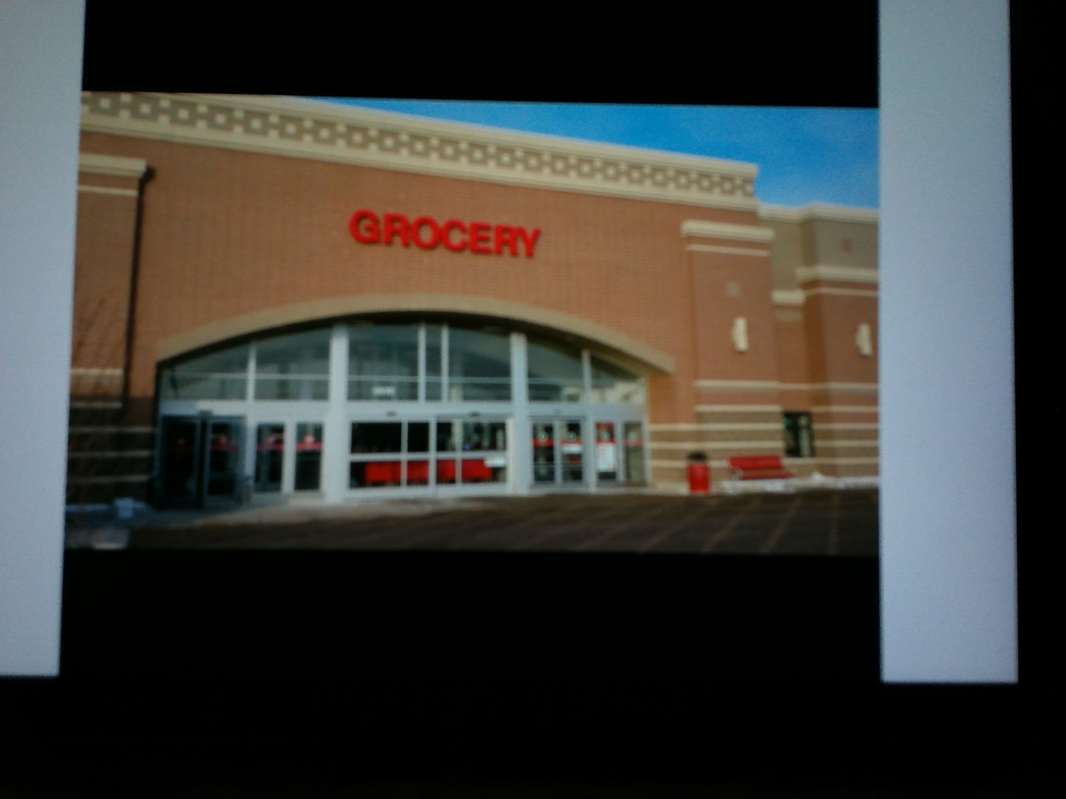
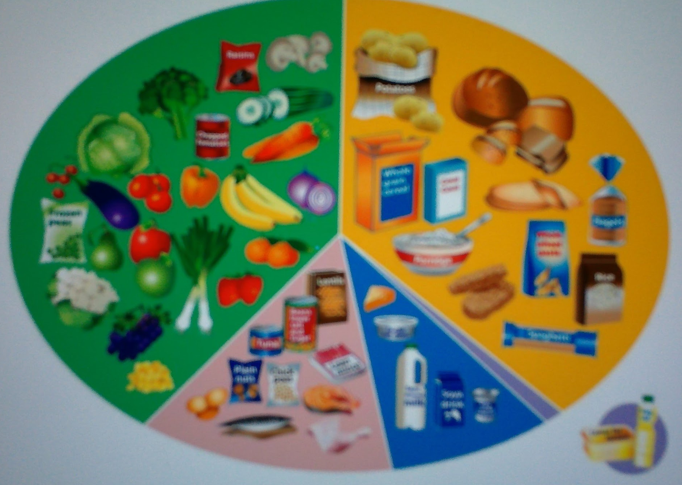
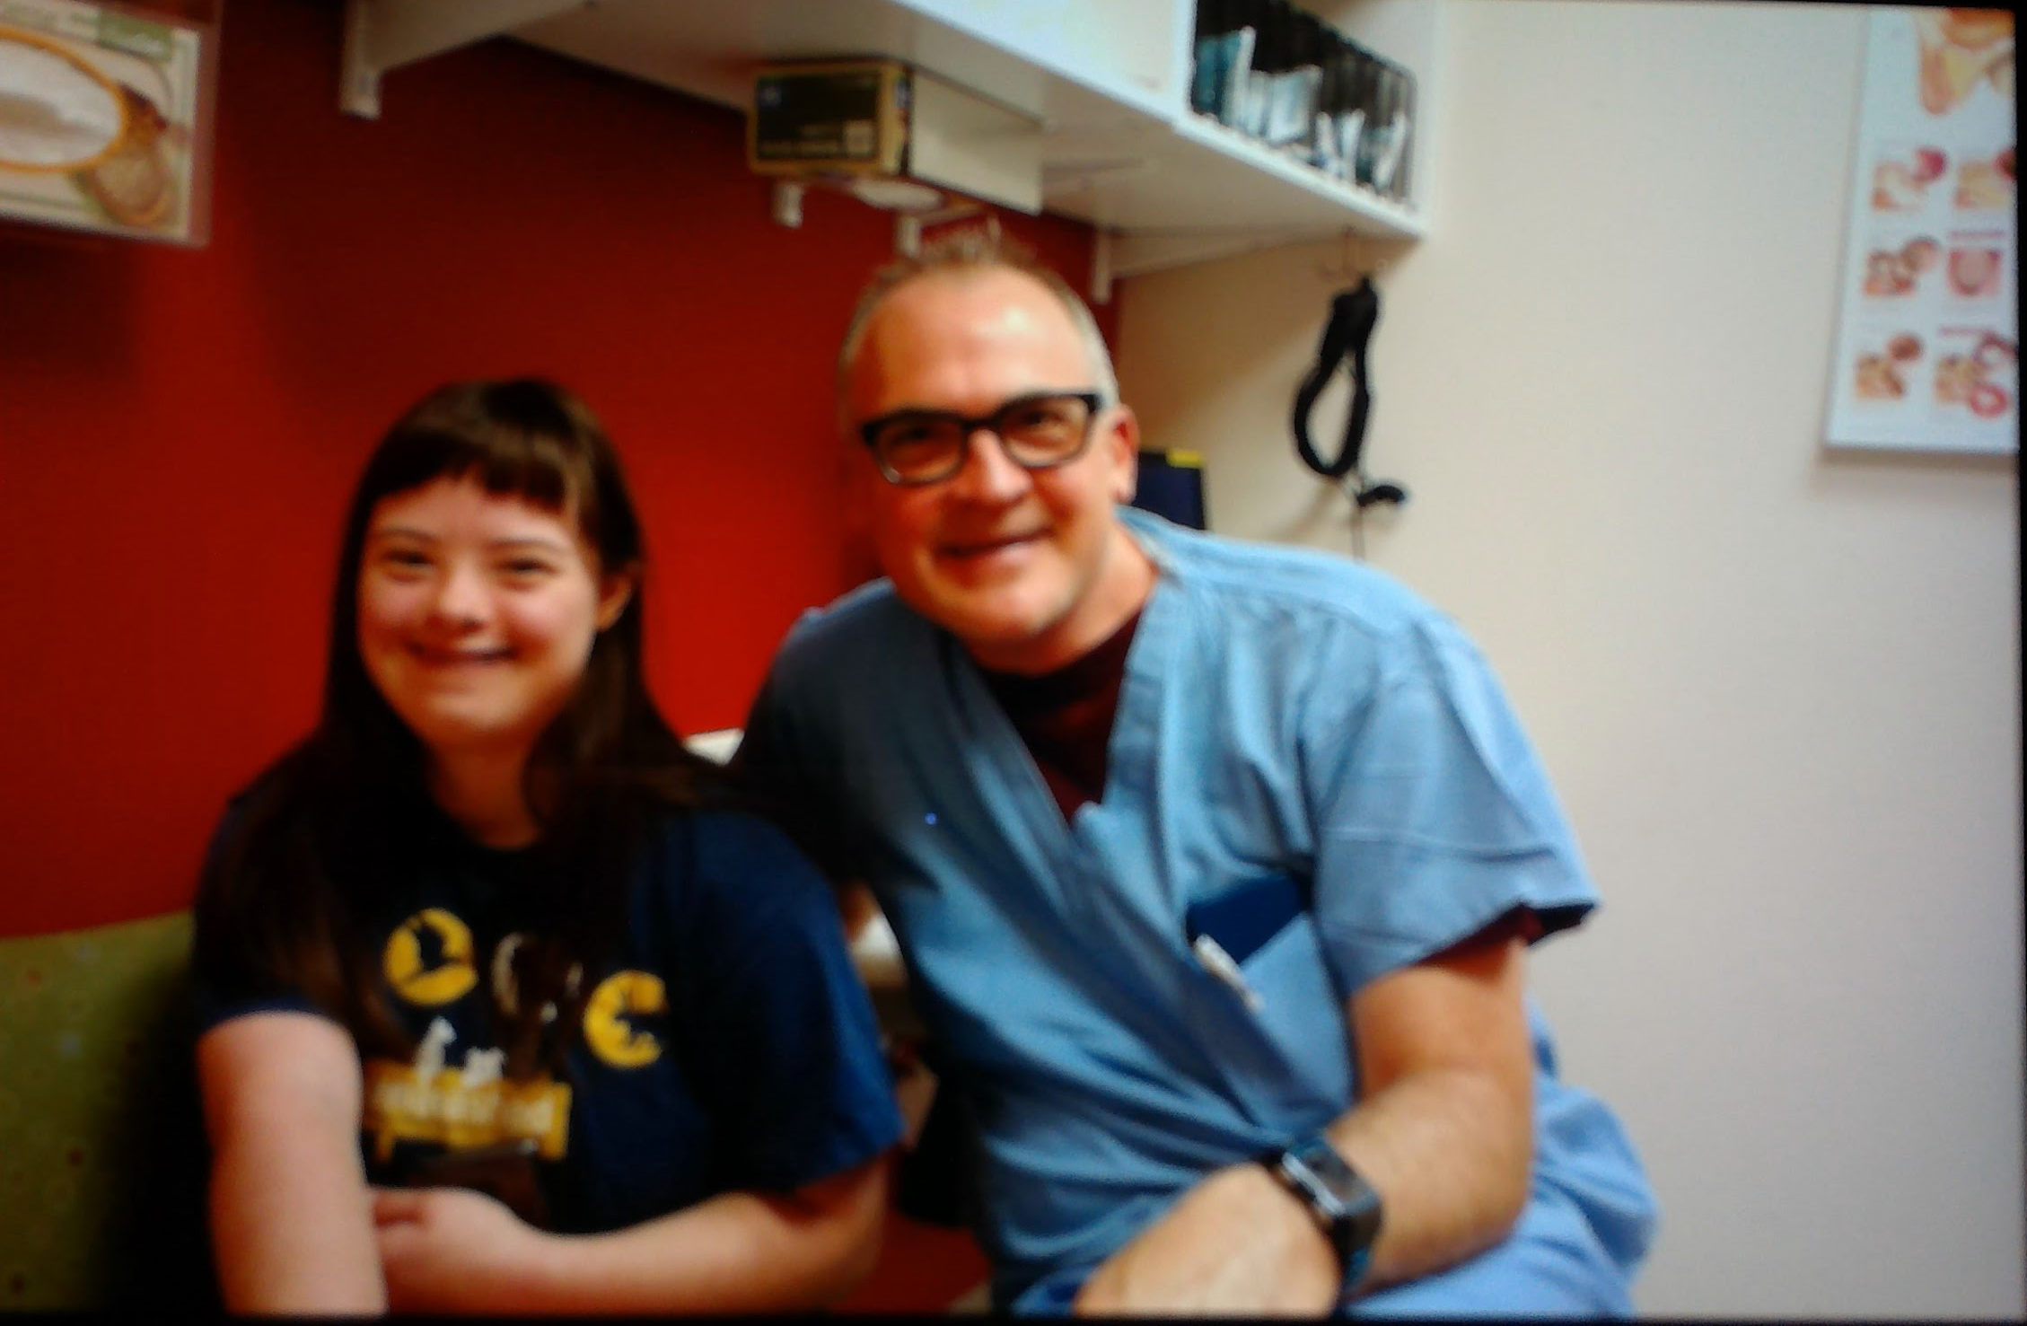
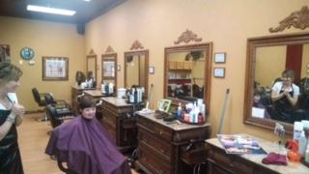
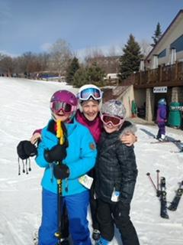
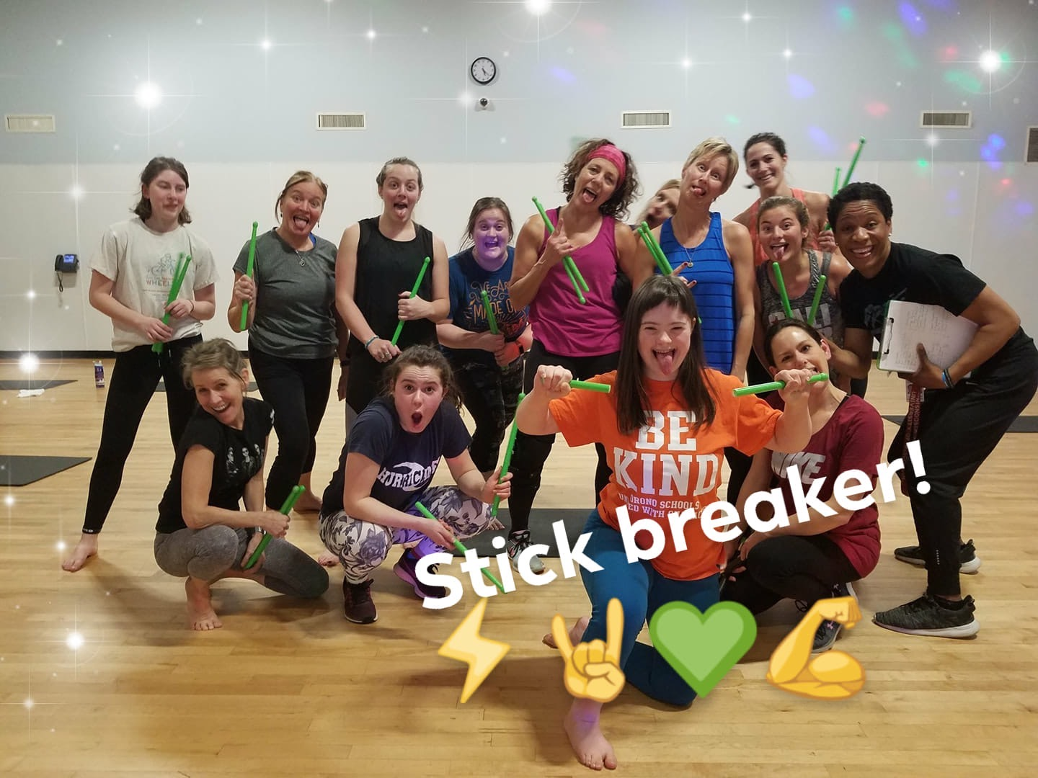
TAKING CARE OF MYSELF
Healthy eating
Cooking
Exercising
Shopping
FOOD AND SNACKS
PERSONAL HYGIENE
CLOTHING
Laundry
Making appointments
Notes:
These pictures are me taking care of myself. I eat healthy, cook, exercise, shop or food and snacks, personal hygiene, clothing, do laundry and make appointments.

Slide 21
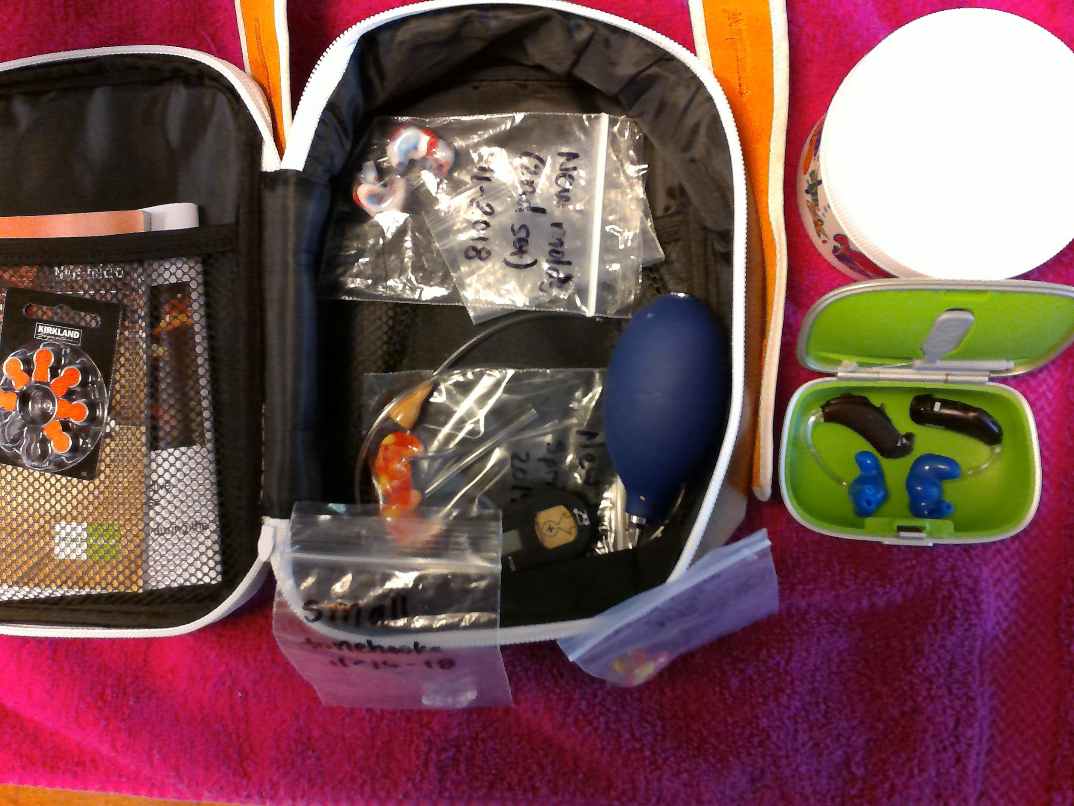
TAKING CARE OF MY HEARING AIDS
Notes:
I take care of my hearing aids. Do demonstration with hearing aids!

Slide 22
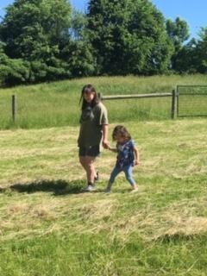
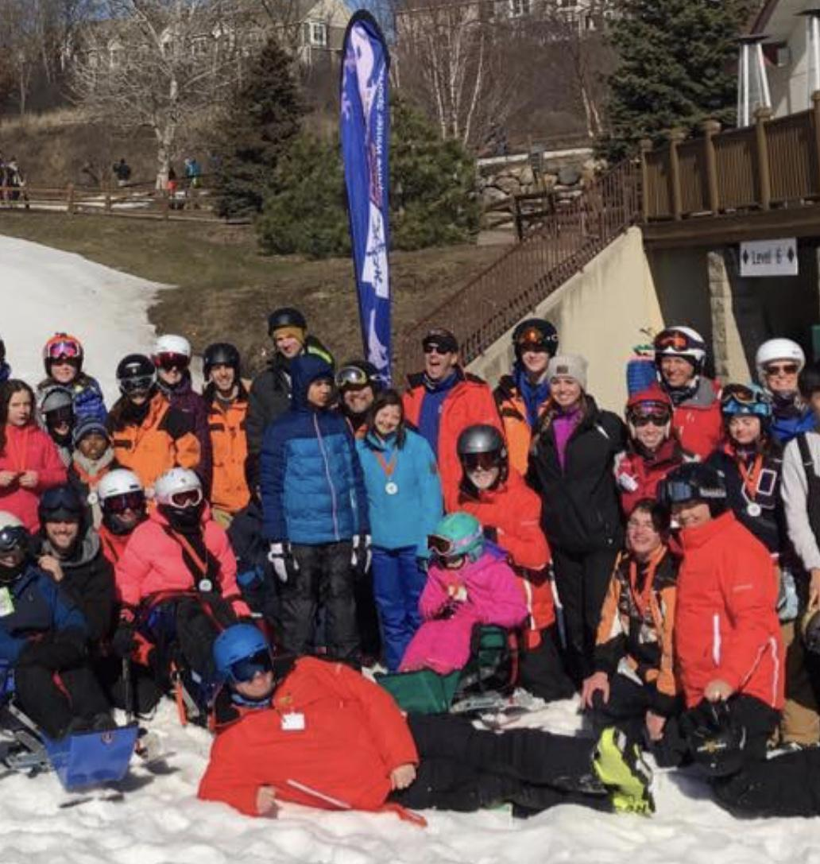
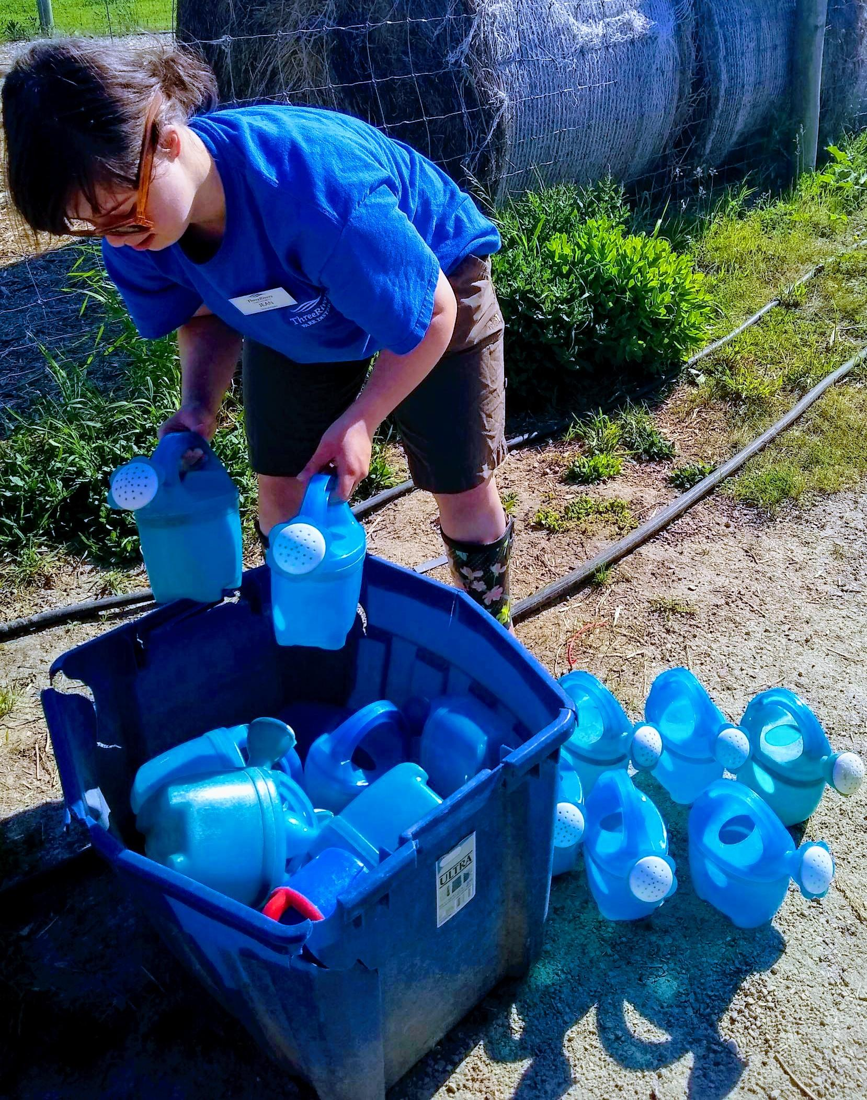
WORKING AND INTERNSHIPS
Exploring Interests and strengths
Volunteering
Gale Woods Farm Padraig’s Place
Notes:
I have volunteer and internship experience. At Gale Wood Farm, I help with little kids and fill the water buckets. At Padraig’s place, I downhill ski.

Slide 23
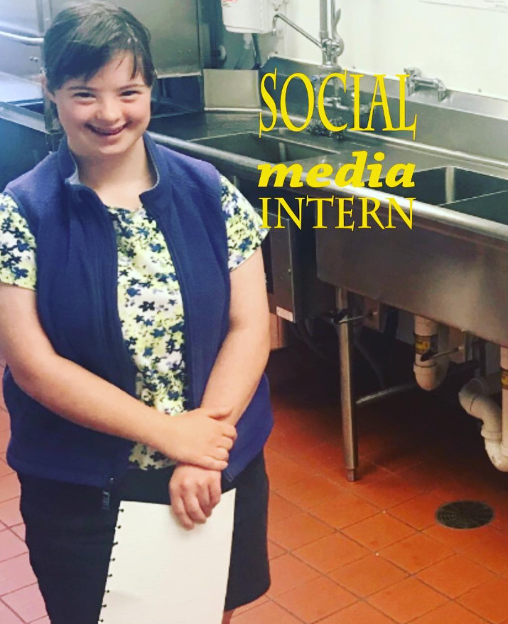
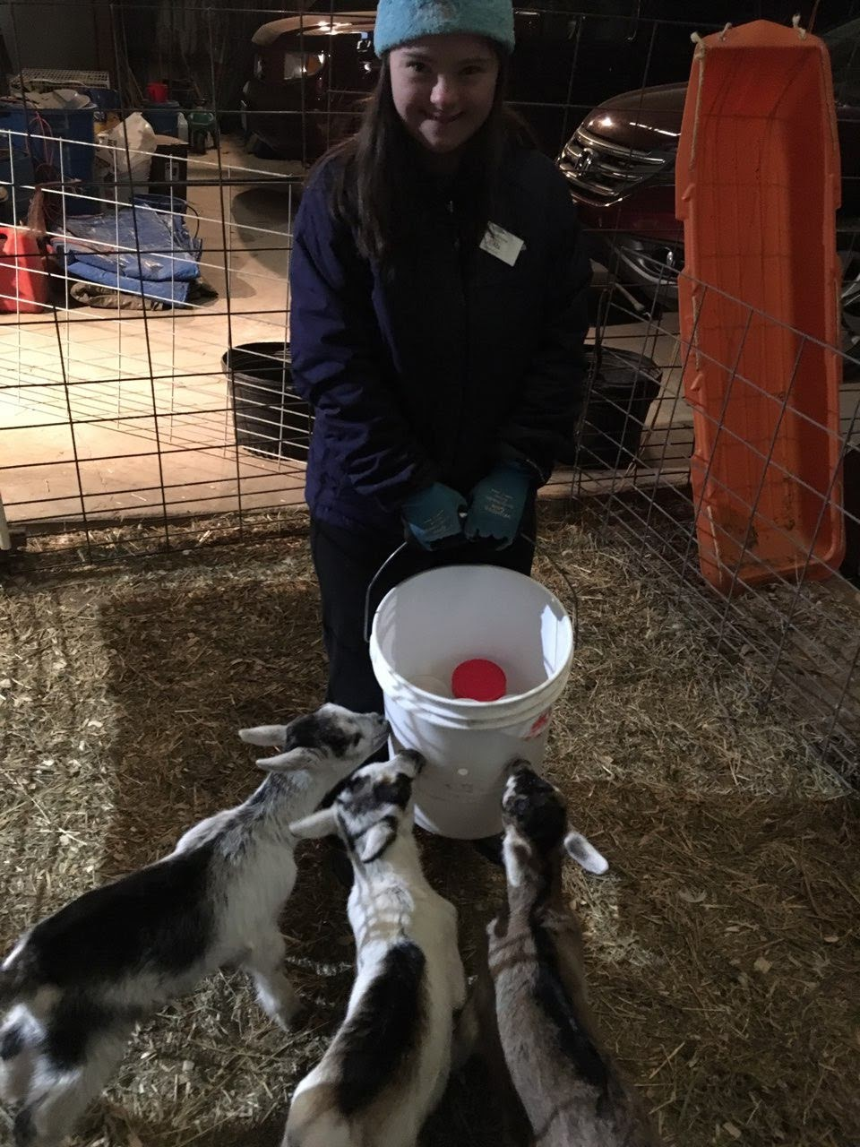
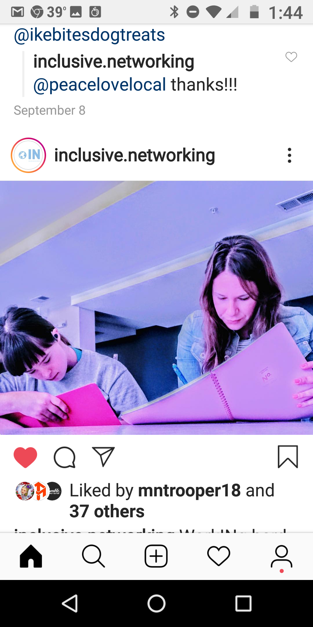
WORKING AND INTERNSHIPS
Exploring Interests and strengths
Internships
Notes:
I am a social media intern for Inclusive Networking. Also, feeding the baby goats. I work with Nicole at Inclusive Networking. I helped with the job and employer panel.

Slide 24
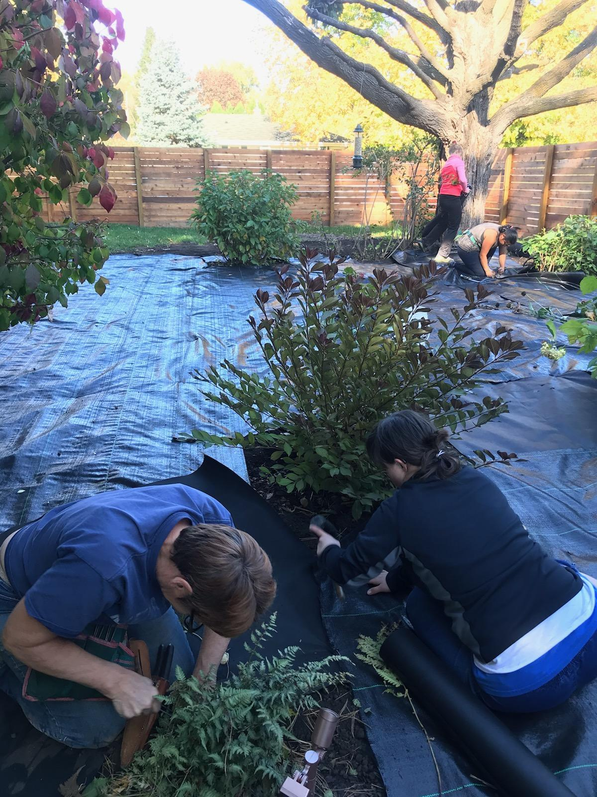
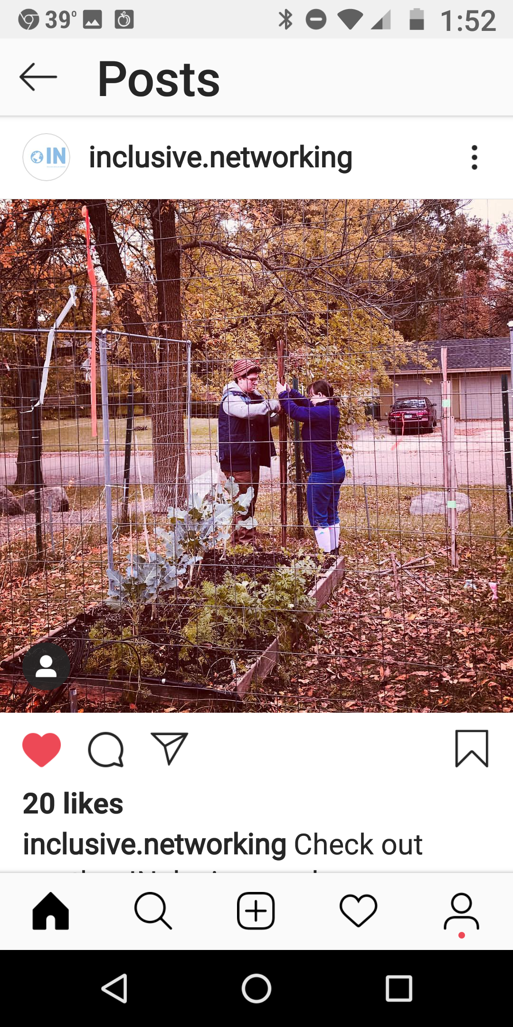
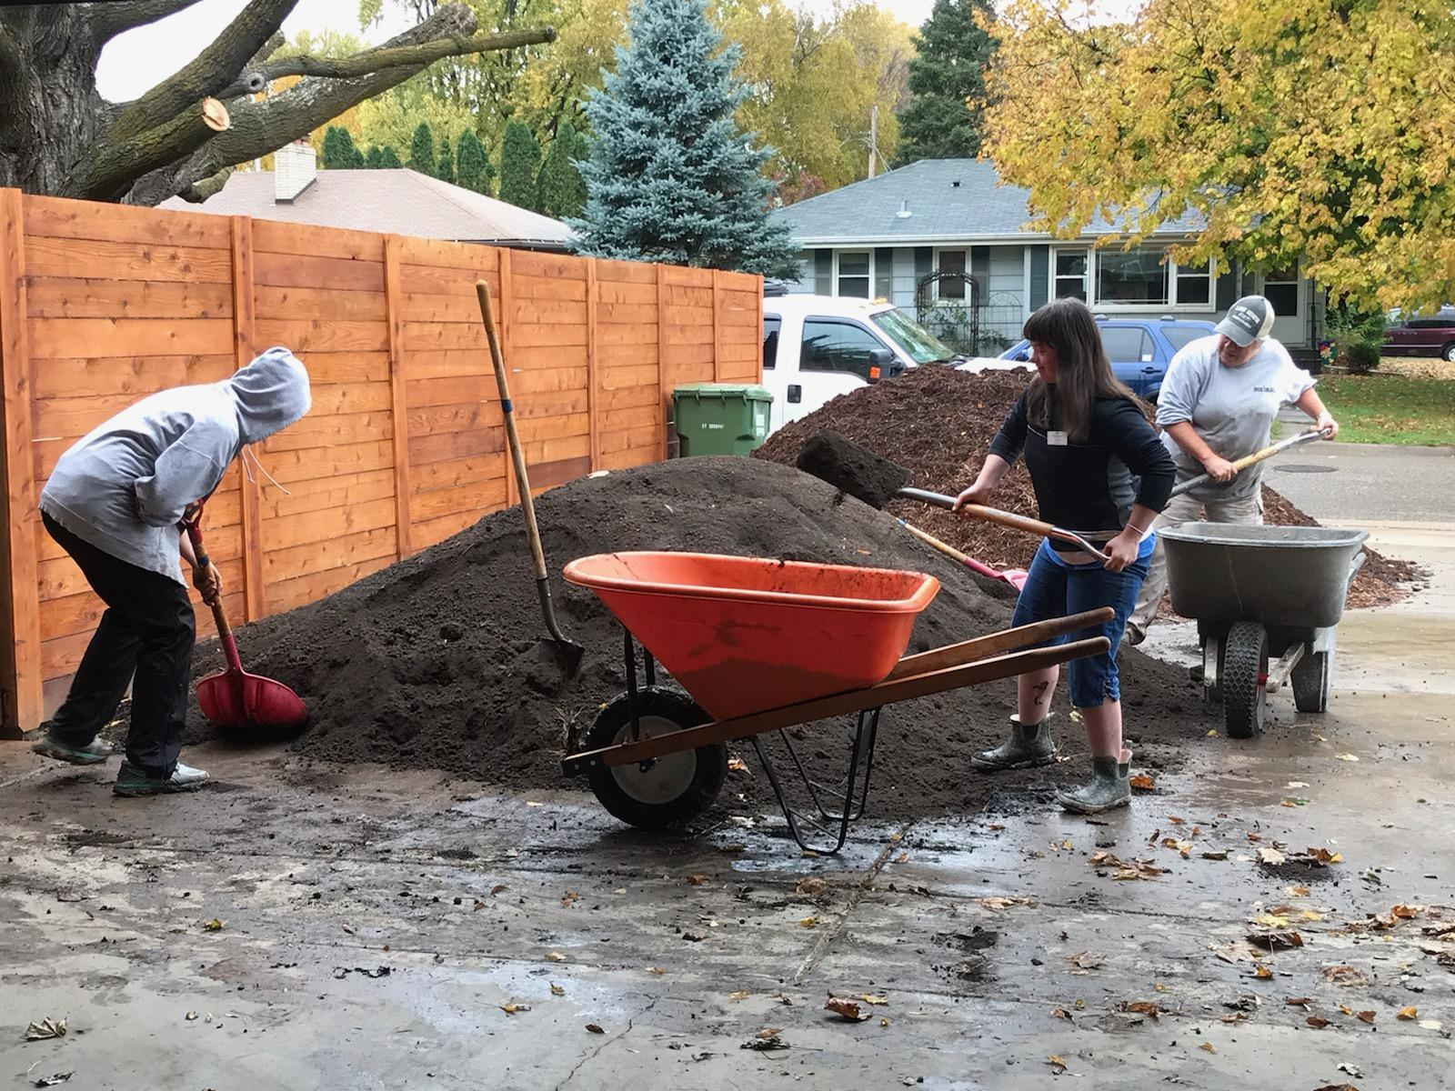
WORKING AND INTERNSHIPS
Exploring Interests and strengths
Employment
A Backyard Farm
Notes:
I have a job at A Backyard Farm. This was me stapling at the garden. I help with little kids to pick vegetables at their garden. I was shoveling dirt for the garden. I get a paycheck.

